Slide 1
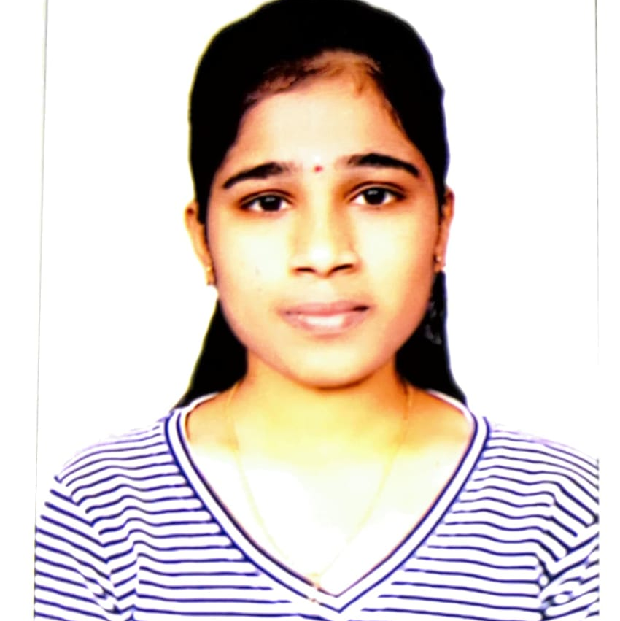


Navanita
Analyst/Software Engineer
Bachelor of Engineering in Electronics and Communication
2017 – 2021
Skills
Dot Net
C#
ADO.NET
ASP .NET Core MVC
ASP.NET Web API
SQL
Database:
MS SQL Server 2014
AddOns:
Git hub
Postman
Additional Details:
Leadership
Quick Learner
Team management
Bangalore
navanita.navanita@capgemini.com
9739597934
A4
A self-driven learner eager to work in a team of dedicated people and serve a key role in the enhancement and development of the project.
Ready to learn new technologies and implement them to further improve my knowledge.
Eager to work in a team of dedicated people and serve a key role in the enhancement and development of the project.
Proficient in C# and OOPs concept.
Hands on experience in developing web pages using HTML5, ASP.NET, Object Oriented Programming.
ATM Bank Management System:
Completed end to end case study of ATN Bank Management system Application along with JWT authentication, Swagger and postman testing using ASP.NET Core Web API.
Trained on Dot Net, SQL Server, ADO.NET, Core MVC, Core Web API, Entity Framework.
Microsoft Azure Certificate : Completed Azure AZ-900 and AZ-104 certificates.

